Slide 1
Sample web pages of CSS

Slide 2
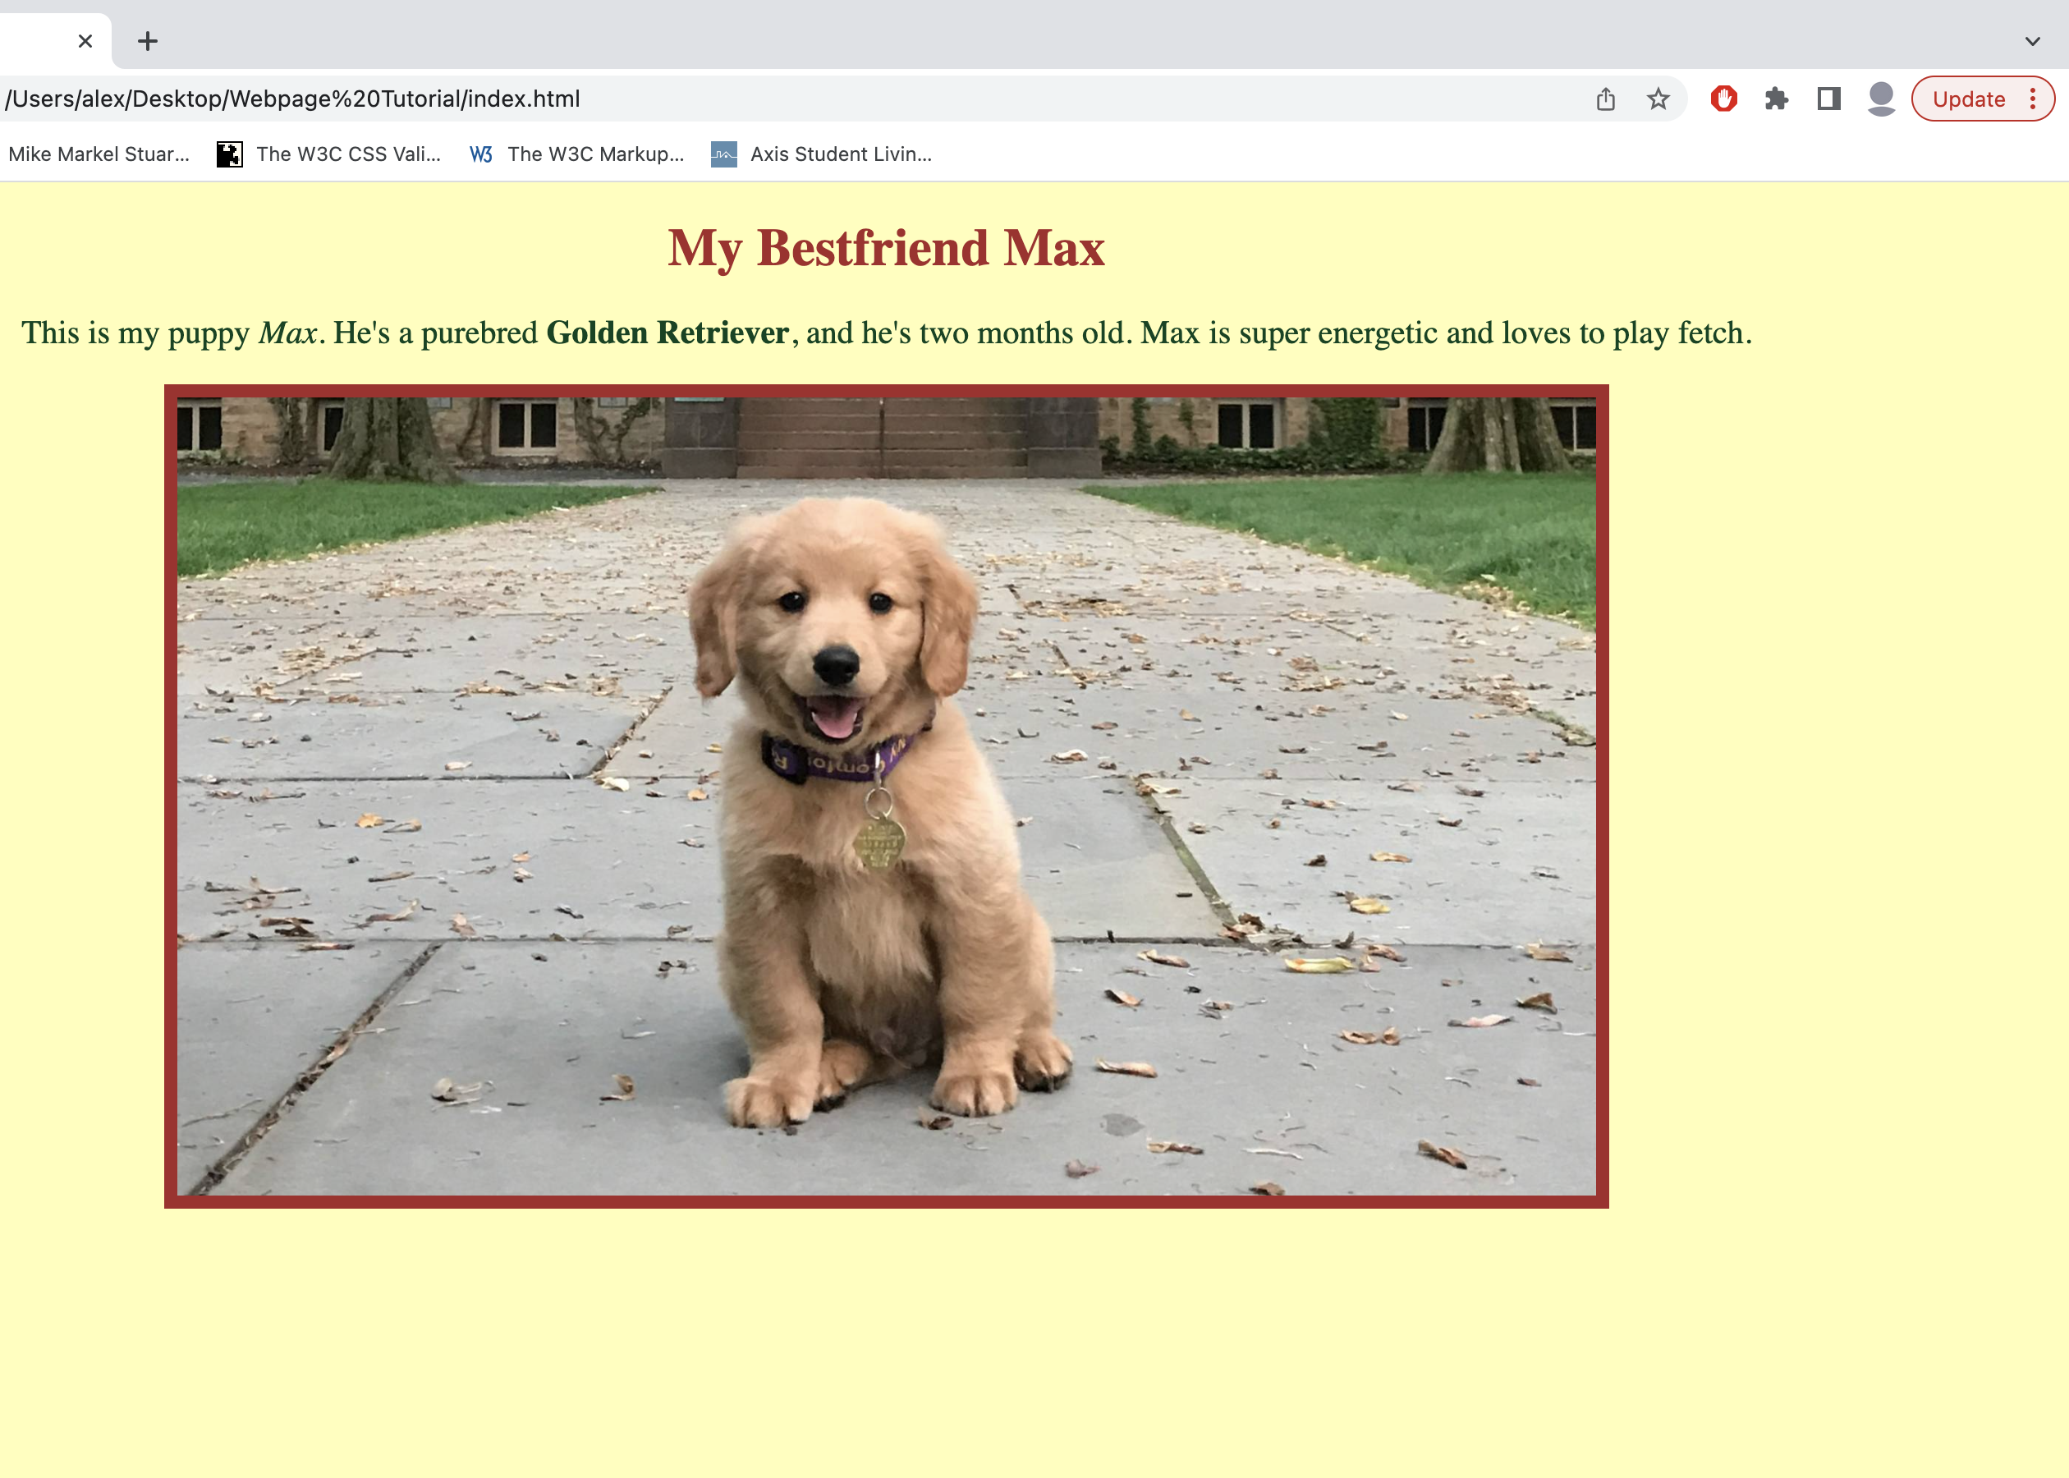
Sample Web page 1 :

Slide 3
Script :
h1 {
color: #b22222; /* dark red */
font-size: 36px;
margin-bottom: 15px;
}
/* Paragraph style */
p {
font-size: 18px;
color: #004d00; /* dark green */
margin-bottom: 20px;
}

Slide 4
p strong {
font-weight: bold;
}
p em {
font-style: italic;
}
/* Puppy image styling */
img {
border: 5px solid #b22222; /* dark red border */
border-radius: 5px;
max-width: 80%; /* responsive */
height: auto;
margin-top: 15px;
}

Slide 5
<html >
<head>
<title>My Bestfriend Max</title>
</head>
<body bgcolor="Yellow">
<h1>My Bestfriend Max</h1>
<p>
This is my puppy <em>Max</em>.
He's a purebred <strong>Golden Retriever</strong>,
and he's two months old. Max is super energetic and loves to play fetch.
</p>
<img src="puppy.jpg" alt="Golden Retriever Puppy Max">
</body>
</html>

Slide 6
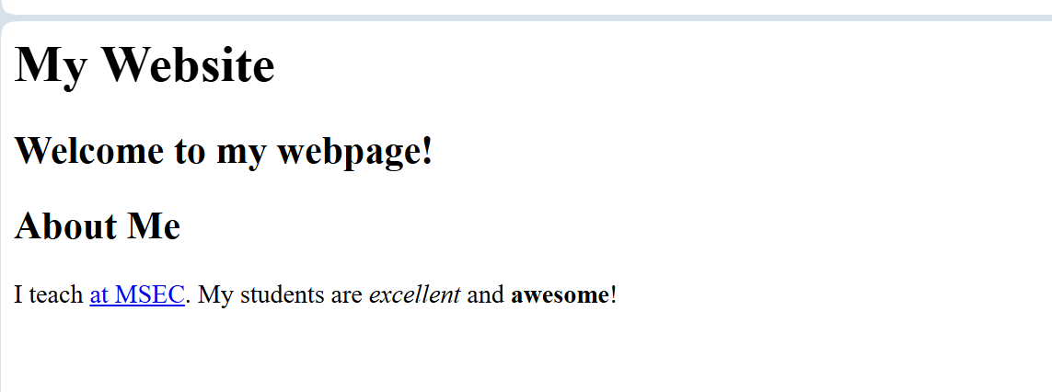
Sample web page 2 :

Slide 7
<?php
body {
background-color: yellow;
font-family: Arial, sans-serif;
padding: 10px;
}
h1 {
color: blue;
font-family: helvetica, sans-serif;
background-color: pink;
border: 5px solid red;
padding: 5px;
}
h2 {
color: pink;
background-color: blue;
border: 2px dotted green;
padding: 5px;
margin-top: 10px;
}

Slide 8
h3 {
color: purple;
background-color: white;
border: 3px double pink;
padding: 5px;
margin-top: 15px;
}
a {
color: darkblue;
text-decoration: none;
font-weight: bold;
}
a:hover {
text-decoration: underline;
}
?>

Slide 9
<html >
<title> My Website</title>
</head>
<body>
<h1> My Website</h1>
<h2>Welcome to my webpage!</h2>
<h2>About Me</h2>
<p>I teach <a href="https://www.ucla.edu" target="_blank">at UCLA</a>.
My students are <em>excellent</em> and <strong>awesome</strong>!</p>
</body>
</html>

Slide 10
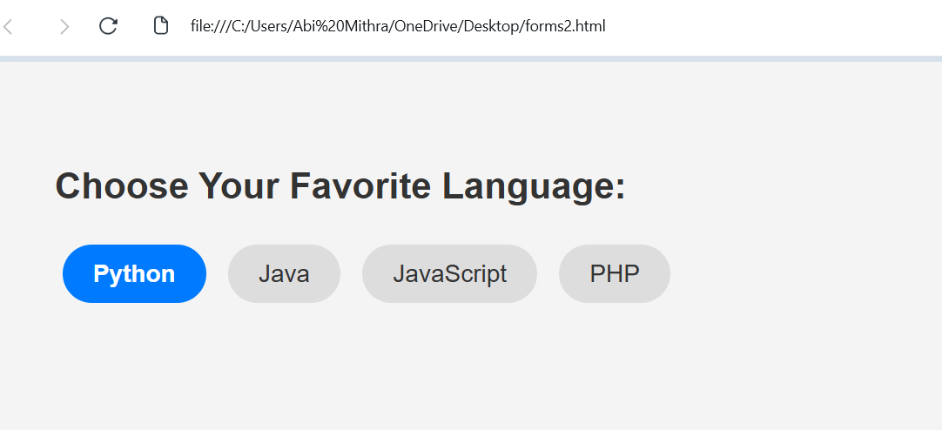
Sample web page 3 :

Slide 11
<html>
<head>
<title>CSS Radio Buttons</title>
<style>
body {
font-family: Arial, sans-serif;
background: #f4f4f4;
padding: 40px;
}
h2 {
color: #333;
}
input[type="radio"] {
display: none;
}

Slide 12
/* Custom label design */
label {
display: inline-block;
background: #ddd;
color: #333;
padding: 10px 20px;
margin: 5px;
border-radius: 25px;
cursor: pointer;
transition: 0.3s;
}
/* Hover effect */
label:hover {
background: #bbb;
}

Slide 13
/* Checked state */
input[type="radio"]:checked + label {
background: #007bff;
color: white;
font-weight: bold;
}
</style>
</head>
<body>
<h2>Choose Your Favorite Language:</h2>

Slide 14
<input type="radio" id="python" name="language">
<label for="python">Python</label>
<input type="radio" id="java" name="language">
<label for="java">Java</label>
<input type="radio" id="js" name="language">
<label for="js">JavaScript</label>
<input type="radio" id="php" name="language">
<label for="php">PHP</label>
</body>
</html

